Slide 1


VISVESVARAYA TECHNOLOGICAL UNIVERSITY
PLANTATION AND ADOPTION OF A TREE
SUBJECT CODE : BSCK307
SUBJECT NAME : SOCIAL CONNECT AND RESPONSIBILITY
NAME : G PRANATHICHOUDRI
USN : 1MV24EC029
SEMESTER : 3rd SEMESTER
SECTION : A SECTION
BRANCH : ELECTRONICS AND COMMUNICATION ENGINEERING
SUBMISSION DATE : 31/10/2025

Slide 2
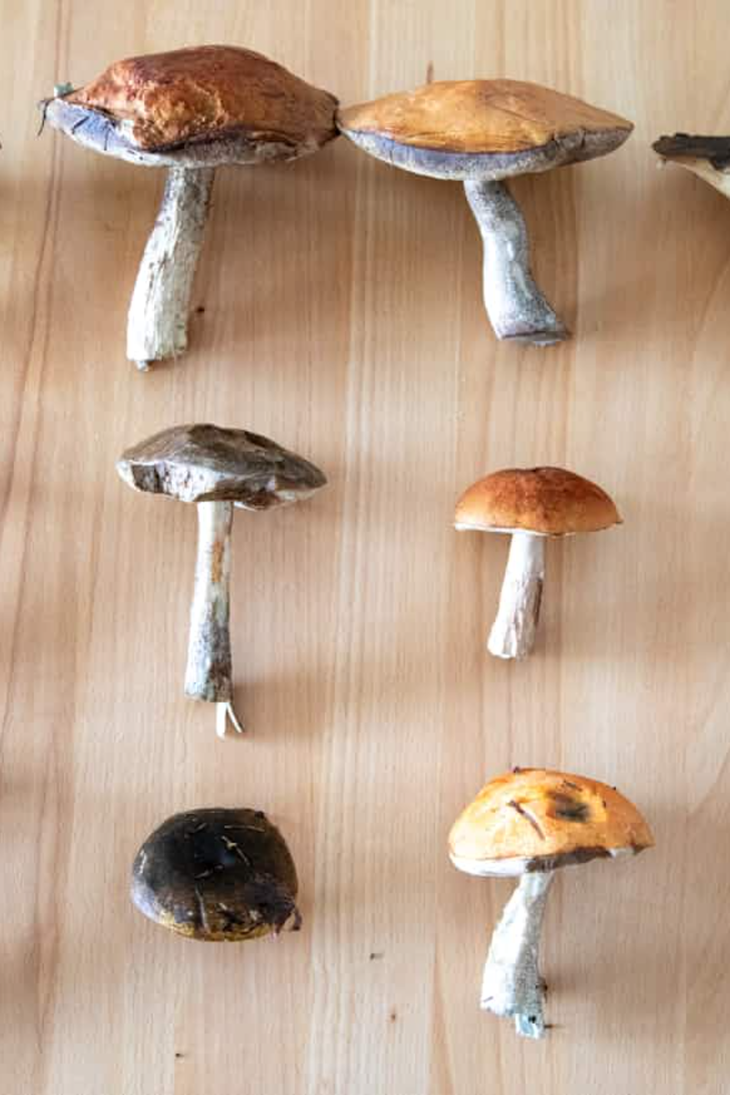
Medicinal Mushrooms
An Integrative Approach to Wellness

Slide 3

The Ancient Remedy: A Timeless Path to Health
For millennia, various cultures have recognized the potent healing properties of fungi, moving them far Beyond the Kitchen and into the realm of therapeutic agents.
From Forage to Pharm
The concept of medicinal mushrooms is not new. Figures like Hippocrates mentioned mushrooms for their anti-inflammatory effects, and they form a cornerstone of Traditional Chinese Medicine (TCM), where species like Reishi (Lingzhi) have been revered for centuries as symbols of longevity and spiritual potency.
Defining Medicinal Mushrooms
These are macroscopic fungi used as food or dietary supplements with the aim of promoting health, stimulating the immune system, and acting as adaptogens—helping the body resist physical, chemical, and biological stressors.

Slide 4



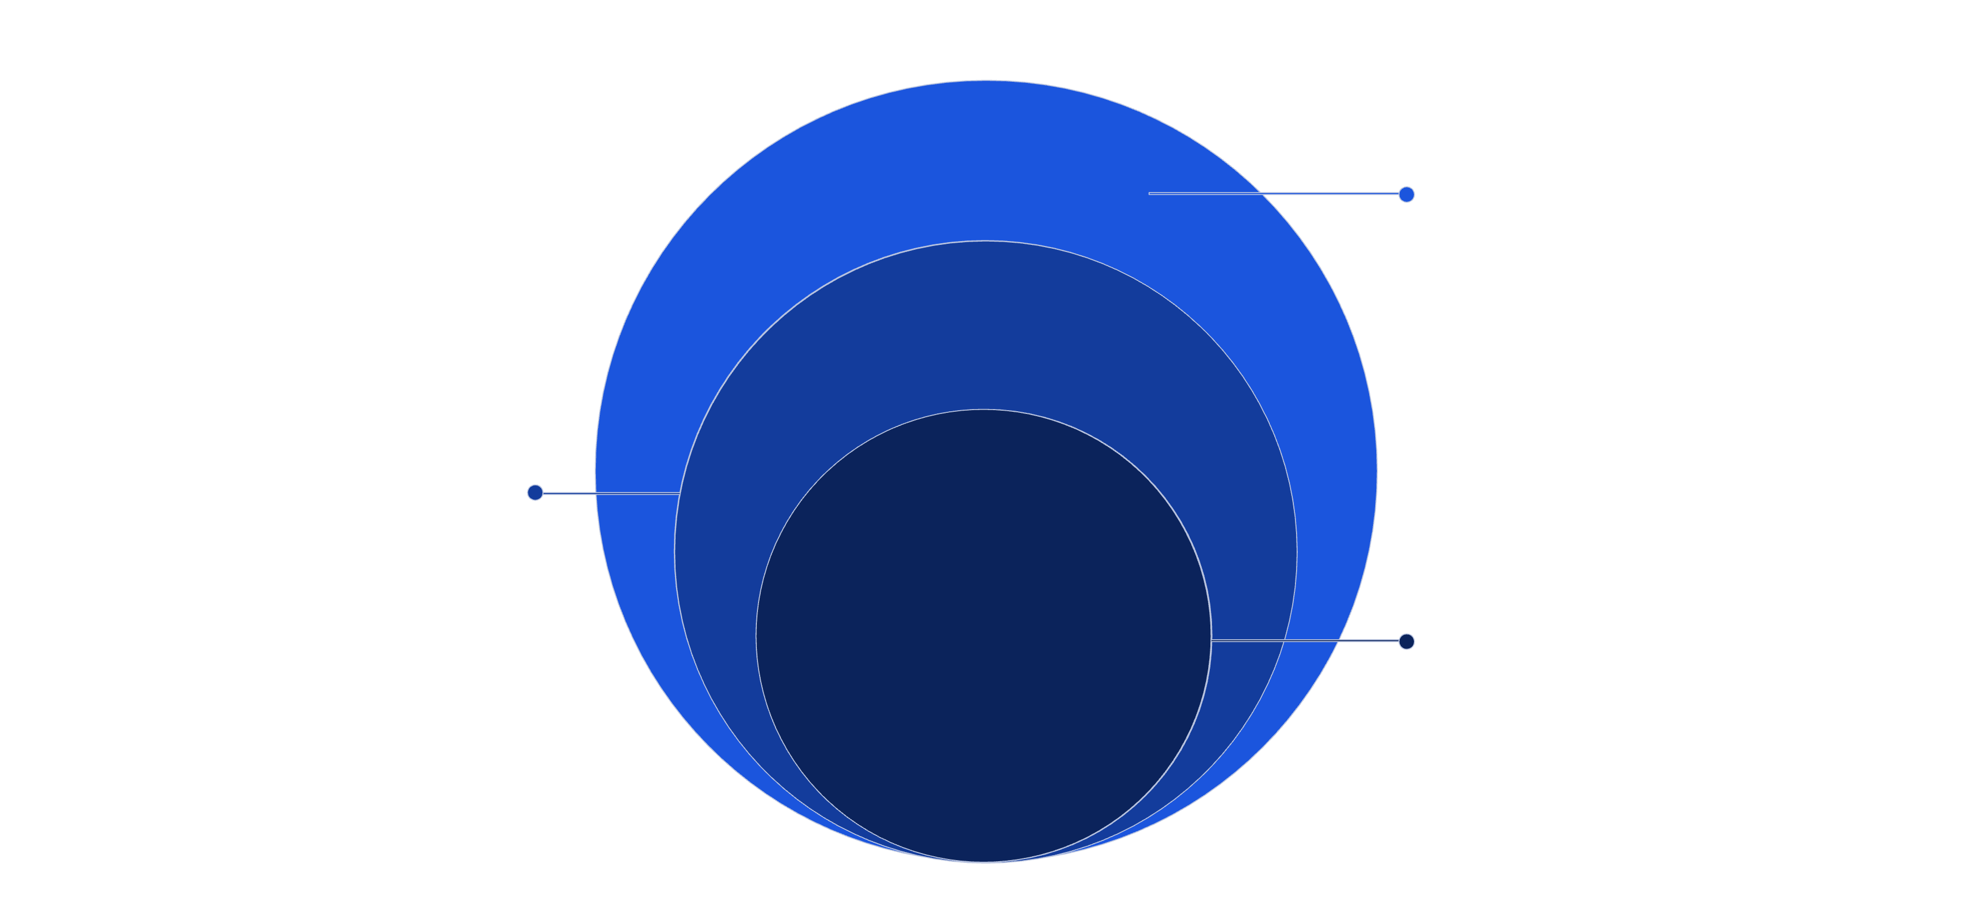
The Bioactive Arsenal: Unpacking the Science
The therapeutic efficacy of medicinal mushrooms is rooted in a rich array of complex compounds, often referred to as nature's Bioactive Arsenal.
Beta-Glucans (β-Glucans)
Triterpenoids
Alkaloids & Nucleosides
Polysaccharides that are the primary compounds responsible for the immunomodulating effects. They interact with receptors on immune cells (like macrophages and natural killer cells) to trigger defensive responses.
Found notably in Reishi, these bitter compounds contribute to the adaptogenic and anti-inflammatory properties. They help regulate histamine release and support liver function.
These compounds, including adenosine and cordycepin (in Cordyceps), play roles in energy metabolism, cardiovascular health, and exhibiting direct antiviral activity.
Focus: Immunomodulation
Cytokine Release
Activation triggers cytokines modulating immunity
Engulfment
Phagocytosis of β-glucan into phagosome
Macrophage Recognition
Receptor binding to β-glucan on cell surface

Slide 5
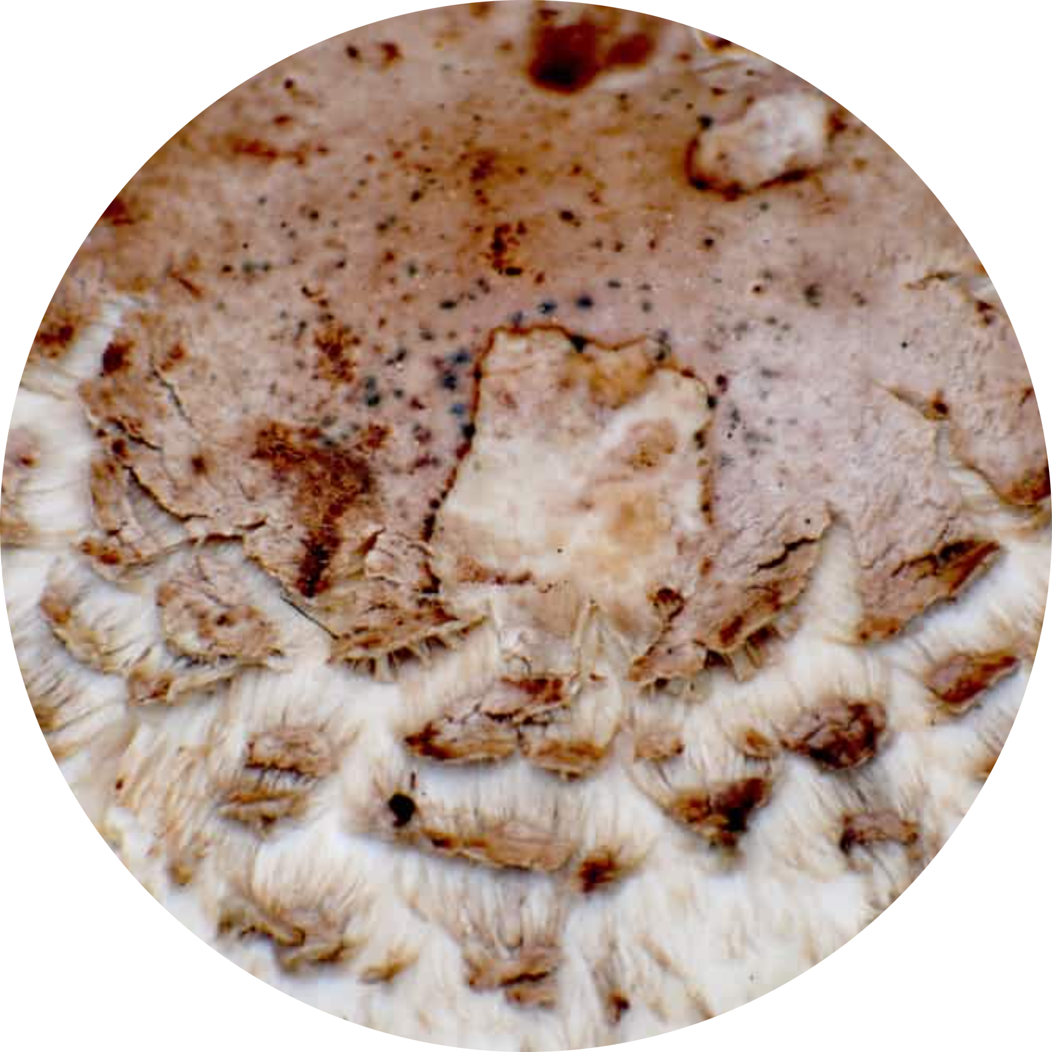
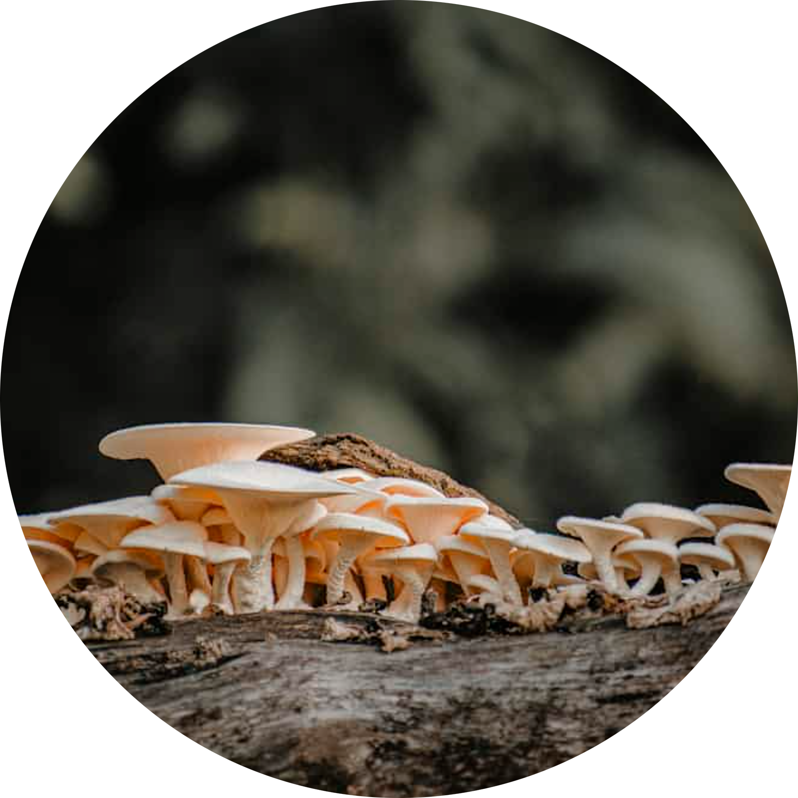
Case Study: Immune & Longevity Support
Two of the most scientifically studied species, Reishi and Turkey Tail, excel in their capacity to support and balance the immune system, contributing to overall vitality and perceived longevity.
Reishi (Ganoderma lucidum)
Turkey Tail (Trametes versicolor)
Referred to as the "Mushroom of Immortality."
Widely used in integrative cancer care, particularly in Asia.
Key compounds: Ganoderic Acids (Triterpenoids).
Key compounds: Polysaccharide K (PSK) and Polysaccharide Peptide (PSP).
Action: Highly adaptogenic, supporting stress response, and promoting restful sleep alongside immune balance.
Action: Powerful immunomodulators that have been shown to enhance natural killer cell activity and overall immune surveillance.

Slide 6
Case Study: Mind & Energy Boosters
Beyond immune support, certain mushrooms target cognitive function and physical performance, establishing themselves as functional foods for the modern, demanding lifestyle.
Lion’s Mane: The Nerve & Brain Tonic
This shaggy fungus is prized for its ability to stimulate neurogenesis. Its compounds, hericenones and erinacines, cross the blood-brain barrier encourage the production Nerve Growth Factor (NGF).
Supports memory and focus.
Potential benefits for nerve regeneration.
Often used to combat "brain fog."
Cordyceps: The Energy Enhancer
Traditionally found high in the Himalayas, Cordyceps is popular among athletes. It supports mitochondrial function, leading to enhanced oxygen utilization and increased production of Adenosine Triphosphate (ATP), the body's primary energy currency.
Boosts endurance and reduces fatigue.
Supports respiratory health.
Natural performance enhancer.

Slide 7

Navigating Supplement Quality: Standardization is Key
As interest in medicinal fungi grows, so does the need for quality assurance. The efficacy of these products is entirely dependent on proper extraction and standardization.
The Extraction Challenge
Fruiting Body vs. Mycelium
The key compounds, like β-glucans and triterpenoids, are locked within the chitin cell walls of the mushrooms, making them indigestible to humans. Therefore, mushrooms must undergo specialized hot water or dual extraction methods to liberate the therapeutic components. Supplements that simply use powdered, unprocessed fungi often lack potency.
The fruiting body (the visible mushroom) is generally considered superior and higher in bioactive compounds compared to mycelium (the root structure), which is often grown on grain starch and may contain high levels of filler.
Testing and Purity
Consumers should look for products standardized to a certain percentage of β-Glucans for guaranteed activity.
Third-party testing is crucial to confirm the absence of heavy metals, pesticides, and other contaminants, ensuring a safe and clean product.

Slide 8




Integrating Ancient Wisdom with Modern Practice
The most exciting aspect of medicinal mushrooms is their role in bridging historical wellness practices with contemporary scientific evidence. They offer a comprehensive, holistic approach to maintaining biological balance.
Holistic Balance (Adaptogens)
Mushrooms assist the body in adapting to stress, helping to maintain homeostasis across multiple systems, rather than targeting a single symptom.
Synergistic Effects
The complex mixture of compounds often works better together than in isolation, a concept known as the "entourage effect," which is central to their therapeutic value.
Evidence-Based Integration
Ongoing clinical trials and meta-analyses continue to validate traditional uses, allowing for confident integration into modern dietary and supplemental regimens.

Slide 9



Conclusion & Future Directions
Medicinal mushrooms are evolving from folk remedies into respected components of integrative wellness. Their established safety profiles and growing body of evidence make them a vital area for future exploration.
Targeted Research
Need for larger, double-blind, placebo-controlled trials to define optimal dosages and long-term effects for specific conditions.
Novel Drug Discovery
Exploiting yet-undiscovered compounds for applications in neurological health, oncology, and metabolic disorders.
Global Standardization
Developing international benchmarks for cultivation, extraction, and standardization to ensure consistent and potent consumer products worldwide.
Harnessing Nature's Fungal Pharmacy

